Slide 1
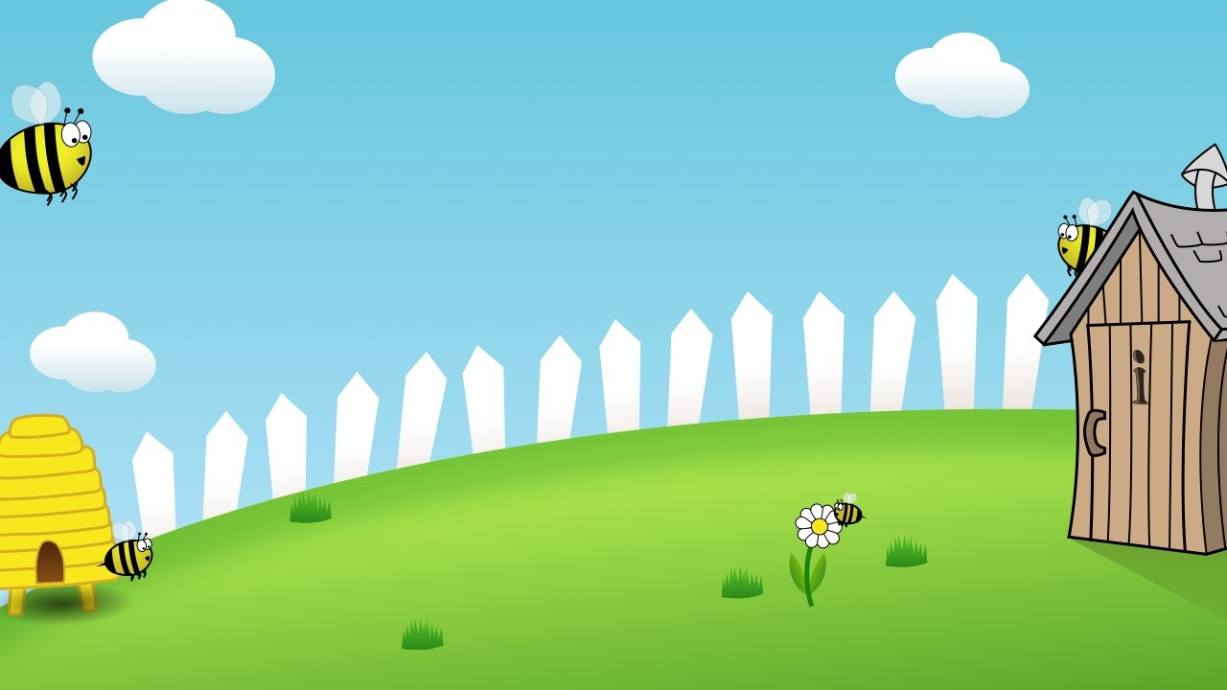
Home Learning
Year 3 -Week 2

Slide 2
3
7
Words with the prefix ’re-’ ‘re-’ means ‘again’ or ‘back.’

Slide 3
3
Words with the prefix ’re-’ ‘re-’ means ‘again’ or ‘back.’
7
Introduction | Today children will look at words starting with ‘re’. Ask the children if they can think of any words beginning with ‘re, write some on the board. Can children guess what ‘re’ means? Explain that it means again or back.
Main Teaching Activity | Using the powerpoint slide, flick quickly through the root words (20-30 seconds per slide) and get children to write the new word by adding ‘re’ and then hold up their whiteboard as soon as they have done it.
Independent Activity | Give children the definition cards, one set per pair. Ask them to work together to write the word that is being described on the back of the card. Share the definitions and practice pronouncing the spellings.
Spellings
redo
refresh
return
reappear
redecorate
revenge
review
replay
reaction
rebound

Slide 4
Add ‘re’ to the word below, write it on your white board as quickly as you can and hold it up!
play

Slide 5
Add ‘re’ to the word below, write it on your white board as quickly as you can and hold it up!
Answer:
replay

Slide 6
Add ‘re’ to the word below, write it on your white board as quickly as you can and hold it up!
fresh

Slide 7
Add ‘re’ to the word below, write it on your white board as quickly as you can and hold it up!
Answer:
refresh

Slide 8
Add ‘re’ to the word below, write it on your white board as quickly as you can and hold it up!
appear

Slide 9
Add ‘re’ to the word below, write it on your white board as quickly as you can and hold it up!
Answer:
reappear

Slide 10
Add ‘re’ to the word below, write it on your white board as quickly as you can and hold it up!
view

Slide 11
Add ‘re’ to the word below, write it on your white board as quickly as you can and hold it up!
Answer:
review

Slide 12
Add ‘re’ to the word below, write it on your white board as quickly as you can and hold it up!
decorate

Slide 13
Add ‘re’ to the word below, write it on your white board as quickly as you can and hold it up!
Answer:
redecorate

Slide 14
Add ‘re’ to the word below, write it on your white board as quickly as you can and hold it up!
action

Slide 15
Add ‘re’ to the word below, write it on your white board as quickly as you can and hold it up!
Answer:
reaction

Slide 16
Print one set of cards for each pair
To do something again. | To freshen something up. | If something makes you jump, this is a __________. | To appear again. | To get someone back for something they did.
To bounce back. | To go back somewhere. | To play it again. | To give your opinion on something. | To decorate something again.

Slide 17
Stage: 3 | Words with the prefix ’re-’ ‘re-’ means ‘again’ or ‘back.’ Name:
List: 7
Spellings | 1st Attempt | 2nd Attempt | 3rd Attempt | 4th Attempt | 5th Attempt
redo
refresh
return
reappear
redecorate
revenge
review
replay
reaction
rebound

Slide 18
Stage: 3 | Words with the prefix ’re-’ ‘re-’ means ‘again’ or ‘back.’ Name:
List: 7
Spellings
redo
refresh
return
reappear
redecorate
revenge
review
replay
reaction
rebound
Use the ‘re-’ prefix to create the words from your spelling list. Can you think of any more?
re + | turn | =
 | fresh
 | play
 | do
 | decorate
 | appear
 | view
 | venge
 | action
 | bound

Slide 19
Stage: 3 | Words with the prefix ’re-’ ‘re-’ means ‘again’ or ‘back.’ Answers:
List: 7
Spellings
redo
refresh
return
reappear
redecorate
revenge
review
replay
reaction
rebound
Use the ‘re-’ prefix to create the words from your spelling list. Can you think of any more?
re + | turn | = | return
 | fresh |  | refresh
 | play |  | replay
 | do |  | redo
 | decorate |  | redecorate
 | appear |  | reappear
 | view |  | review
 | venge |  | revenge
 | action |  | reaction
 | bound |  | rebound

