Slide 1
Egyptian necklaces

Slide 2
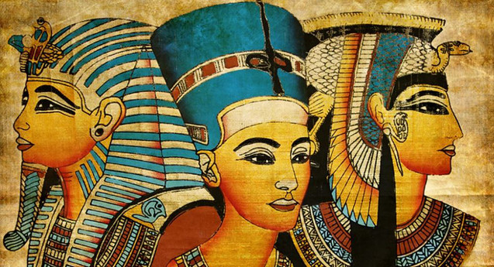

Slide 3
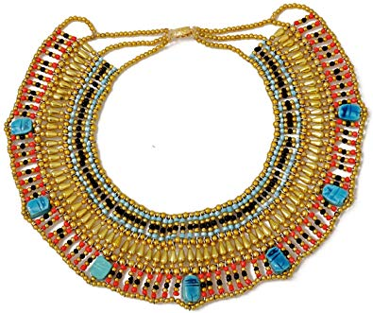
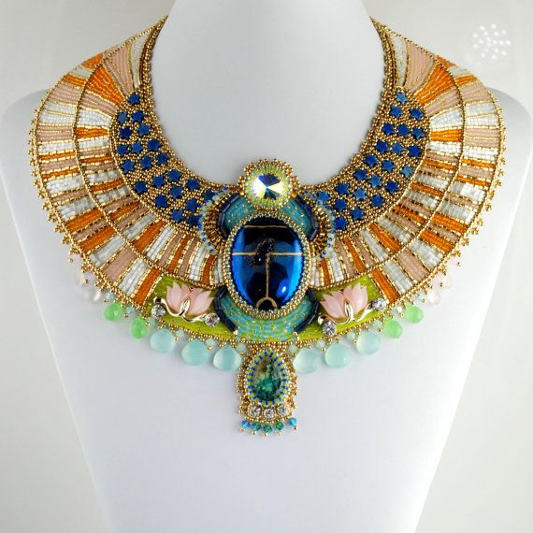
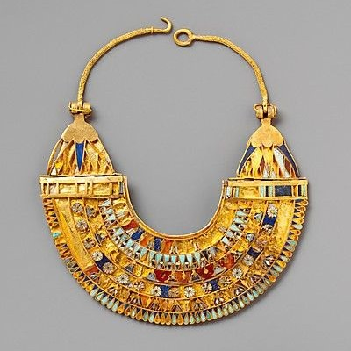
Some examples of Egyptian necklaces

Slide 4
Analyse and Evaluate
Which materials do you think the necklaces are made from?
Why do you think these materials were chosen?
Who do you think wore these necklaces?
What do you like about these necklaces?
What don’t you like about these necklaces?

Slide 5
Facts about Egyptian necklaces
The ancient Egyptians adored jewellery and loved to wear a variety of necklaces and collars made from a huge range of materials.
Of course, only the wealthy could afford gold, silver or precious stones, but shells, wood and bone were more readily available to those on a more restricted budget.
Wealthy Egyptians could afford to buy beautifully crafted pieces of jewellery, but even those who could not afford the works of lesser craftsmen could employ their own ingenuity to make lovely pieces with which to adorn themselves.

Slide 6
More facts about Egyptian necklaces
In art the upper classes and the gods are almost always shown wearing a significant quantity of jewellery as a mark of their status.
This particularly relates to collars and necklaces made from precious metals as these pieces of jewellery were often given as gifts by the pharaoh to loyal supporters, making them a great source of personal pride.
In biographies inscribed on the walls of their tombs, successful Egyptians are not slow to boast of every occasion that their king rewarded their actions with a gift of a gold necklace!

Slide 7
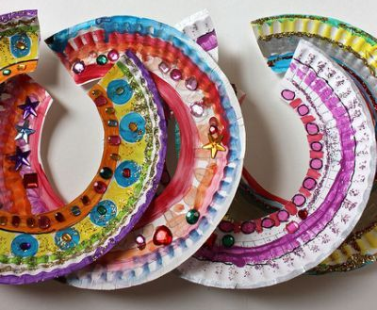
You are going to design and make your own Egyptian collar necklace

